Slide 1
Making this resource work for you
Prior to teaching this lesson, please refer to the ‘Unit Overview and Planning Document’.
Further guidance on planning Science Mastery lessons can be found in the detailed planning guidance document.
Refer to the ‘notes’ section on each slide for useful information, including suggested expositions, pedagogical content knowledge, suggested questions, answers and more. Consider using presenter mode so you can see this guidance throughout the lesson.
The introduction slides can be adapted to suit your teaching style and the needs of your class.
Before the lesson, adapt the fix-it slide to address any misconceptions identified in the previous lesson’s exit ticket.
Choose from the suggested activities to suit your class. The intention is not that you complete all of these, but that you select those which ones are most appropriate for your students. It may be appropriate to further adapt activities for your students.
These lessons are designed to occupy approximately 1 hour. To adapt for a shorter or longer lesson duration we advise you to adapt the activity section accordingly.
Please consider using the final slide to send feedback about this lesson or examples of PowerPoints that you have adapted to our design team. Your feedback is used to improve Science Mastery for all of our teachers and students. We appreciate all suggestions and comments.
Thank you for reading!
The Science Mastery Team

Slide 2
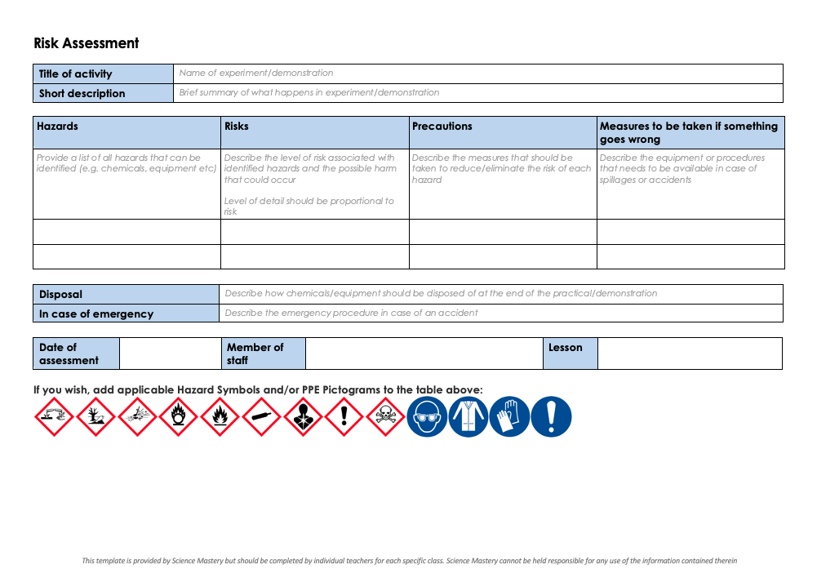
Practical Activity
This lesson contains a practical activity (either a whole class activity or a demonstration)
A risk assessment must be completed for this practical
The template risk assessment can be found here.
The risk assessment should be specific to the class involved and written only by the teaching member of staff
The risk assessment should refer to the current CLEAPSS Hazcards for all chemicals used in the practical for safety and disposal notes.
A list of chemicals used can be found in the Practical Guide
It is good practice for students to wear safety spectacles during all class practicals and demonstrations
Thank you for reading!
The Science Mastery Team

Slide 3
Aseptic Technique
Answer the questions below.
Describe the difference between eukaryotic and prokaryotic cells.
Describe the function of mitochondria in eukaryotic cells.
Give an example of a eukaryotic and a prokaryotic cell.
Describe the difference between unicellular and multicellular organisms.
State an example of a unicellular organism.
Eukaryotic cells contain a nucleus and membrane-bound organelles, prokaryotic cells contain DNA in a plasmid or loops in the cytoplasm.
They are the site of aerobic respiration, which releases energy for the cell.
Plant and animal cells are eukaryotic, bacteria are prokaryotic.
Unicellular organisms are made up of one cell only, whereas multicellular organisms can be made up of any number of cells organised into tissues, organs and systems.
Bacteria, yeast, amoeba
Notes:
Foundation: State the function of the cell membrane.
Stretch: Compare the relative sizes of eukaryotic and prokaryotic cells and how you would investigate them under a microscope.
Answers:
Foundation: Controls the movement of substances into and out of the cell.
Stretch: Eukaryotic cells are typically between 10-100 micrometres in size, whereas prokaryotic cells are typically between 1 and 10 micrometres in size, closer to the size of a mitochondrion. Therefore an electron microscope would be required to observe prokaryotic cells due to the greater magnification it has compared to a light microscope. A light microscope has sufficient magnifying power to observe eukaryotic cells.

Slide 4
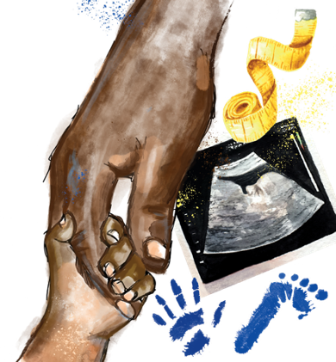
B3.1.3
12/04/2024
Aseptic Technique
B3.1.1 Prior Knowledge Review
B3.1.2 Eukaryotic and Prokaryotic Cells
B3.1.3 Aseptic Technique
B3.1.4 Growth of Bacteria
B3.1.5 Microscopes
B3.1.6 Observing Cells
B3.1.7 Diffusion
B3.1.8 Diffusion in Living Things
B3.1.9 Osmosis
B3.1.10 Osmosis Investigation
B3.1.11 Active Transport
B3.1.12 Cell Division
B3.1.13 Cancer
B3.1.14 Stem Cells
Notes:
Big Idea: Cells are alive
This lesson is not a required practical but is useful for pupils to learn about the technique to deepen their understanding of how science is practiced in real life. Aseptic technique and the growth of bacteria are GCSE Biology single science content rather than Combined but it is still an interesting practical for pupils to understand and can help them understand the function of antibiotics and the problems caused by antibiotic resistance. This lesson solely focuses on the method of the aseptic technique but is good practice to give pupils an opportunity to make sure they have carried out the method accurately before they move on to growing bacterial cultures.
Suggested Hook:
Scientists that do experiments with cells often have to work in sterile conditions, with no unwanted microorganisms, such as bacteria or fungi, growing. How do you think they do this? You could ask pupils to think back to COVID guidelines for preventing the spread of disease - washing hands thoroughly with soap and using social distancing and masks to prevent the spread of viruses.

Slide 5

Following this lesson, students will be able to:
State the stages of aseptic technique when growing bacteria
Describe the function of the agar medium
Explain why the Petri dish is not secured with an airtight seal when growing bacteria
Key Words:
aseptic
antibiotic
culture
agar medium
inoculating loop
sterilisation

Slide 6
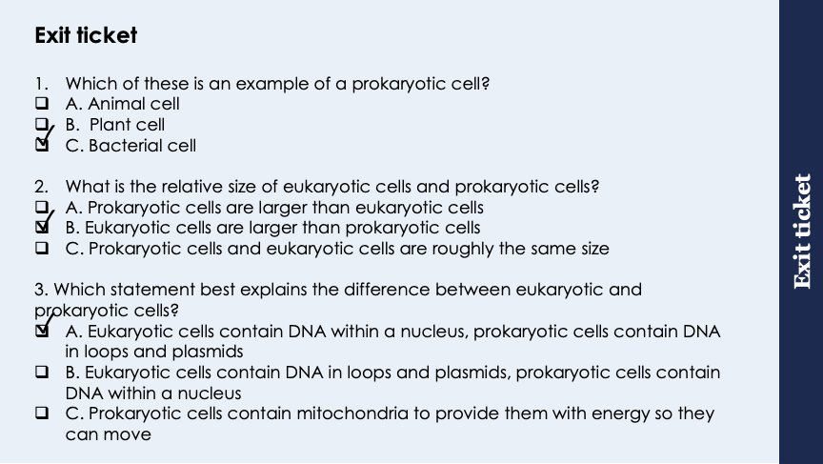
This is the fix-it portion of the lesson
The fix-it is an opportunity to respond to gaps in knowledge, especially those identified by the previous lesson’s exit ticket.
The teacher should customise this slide as needed, to facilitate
reteach, explanation, demonstration or modelling of ideas and concepts that students have not yet grasped or have misunderstood.
practise answering specific questions or of key skills.
redrafting or improving previous work.
Notes:
Purpose: to spend time on any gaps identified in previous learning from exit ticket feedback.
Answers
Q1. Answer: C
If pupils answer A or B they have misunderstood the definition of a prokaryotic cell.
To fix it revisit definitions of a eukaryotic/prokaryotic cells and highlight the prefix ‘eu’ that means true/all. Alternatively rhyme ‘eu’ with ‘you’ so eukaryotic cells make up you or what you can see ie animals and plants.
Q2. Answer: B
Incorrect answers pupils may have the misconception that cells are the simplest form of life, what they have learnt about so far are plant and animal cells so think they are smaller. To fix it remind pupils that prokaryotes are on average 10 times smaller than eukaryotes and that they are often the size of a nucleus or mitochondria thus are too small to contain either.
Q3. Answer: A
If students answer C they have been distracted by the new information and assume that mitochondria and flagellum must go together to allow the bacteria to move. To fix it, it may be useful to recap the structures of both types of cells, followed by questioning to ensure they can identify the features/relative sizes.

Slide 7
General Definition
Scientific Definition
Noun:
The ideas, customs and social behaviours of a group or society.
The arts
From the Latin cultura
The growing of microorganisms (such as bacteria) for scientific study.
Culture
‘Understanding languages and other cultures builds bridges’.
Suzy Kassem
Synonyms
General Examples
Social media has become a big part of popular culture.
People can visit places to learn about other cultures.
Traditions
Customs
The arts
Scientific Examples
We can grow a culture of mould on a piece of bread.
Notes:
Purpose of this slide:
The purpose of the Frayer organiser is to address key scientific vocabulary that students may be familiar with from a non-scientific context. Addressing this at the beginning of the lesson limits the potential cognitive conflict that might arise if students are using their current non-scientific interpretation of a term to understand the science being learned. This approach limits the potential for misconceptions and confusion arising from differing scientific and non-scientific uses of the same word.
The use of this slide is intended to clearly show students
how a word can have both scientific and non-scientific meanings simultaneously
the correct usage of a word in both a scientific and non-scientific context
Teacher guidance:
This slide should be used briefly. Do not dwell on each portion of the slide as this can eat into the lesson quite quickly.
This might be an apt opportunity to ask students to write the scientific definition of the key term into their books. Alternatively, you may want to wait to do this until the term is addressed in more depth later in the lesson.
Suggested narration:
Here we have the word ‘X’. You many already be familiar with this word [display general examples and general definition] in this context. Well, in science, we use this term slightly differently. [display scientific example]. [Display scientific definition]. In science when we use this word what we actually mean is this. You can see that words which mean the same include X,Y and Z. Words that mean the opposite include A, B an C. From this point in the lesson when we refer to this word we’ll be using it in the scientific sense.

Slide 8
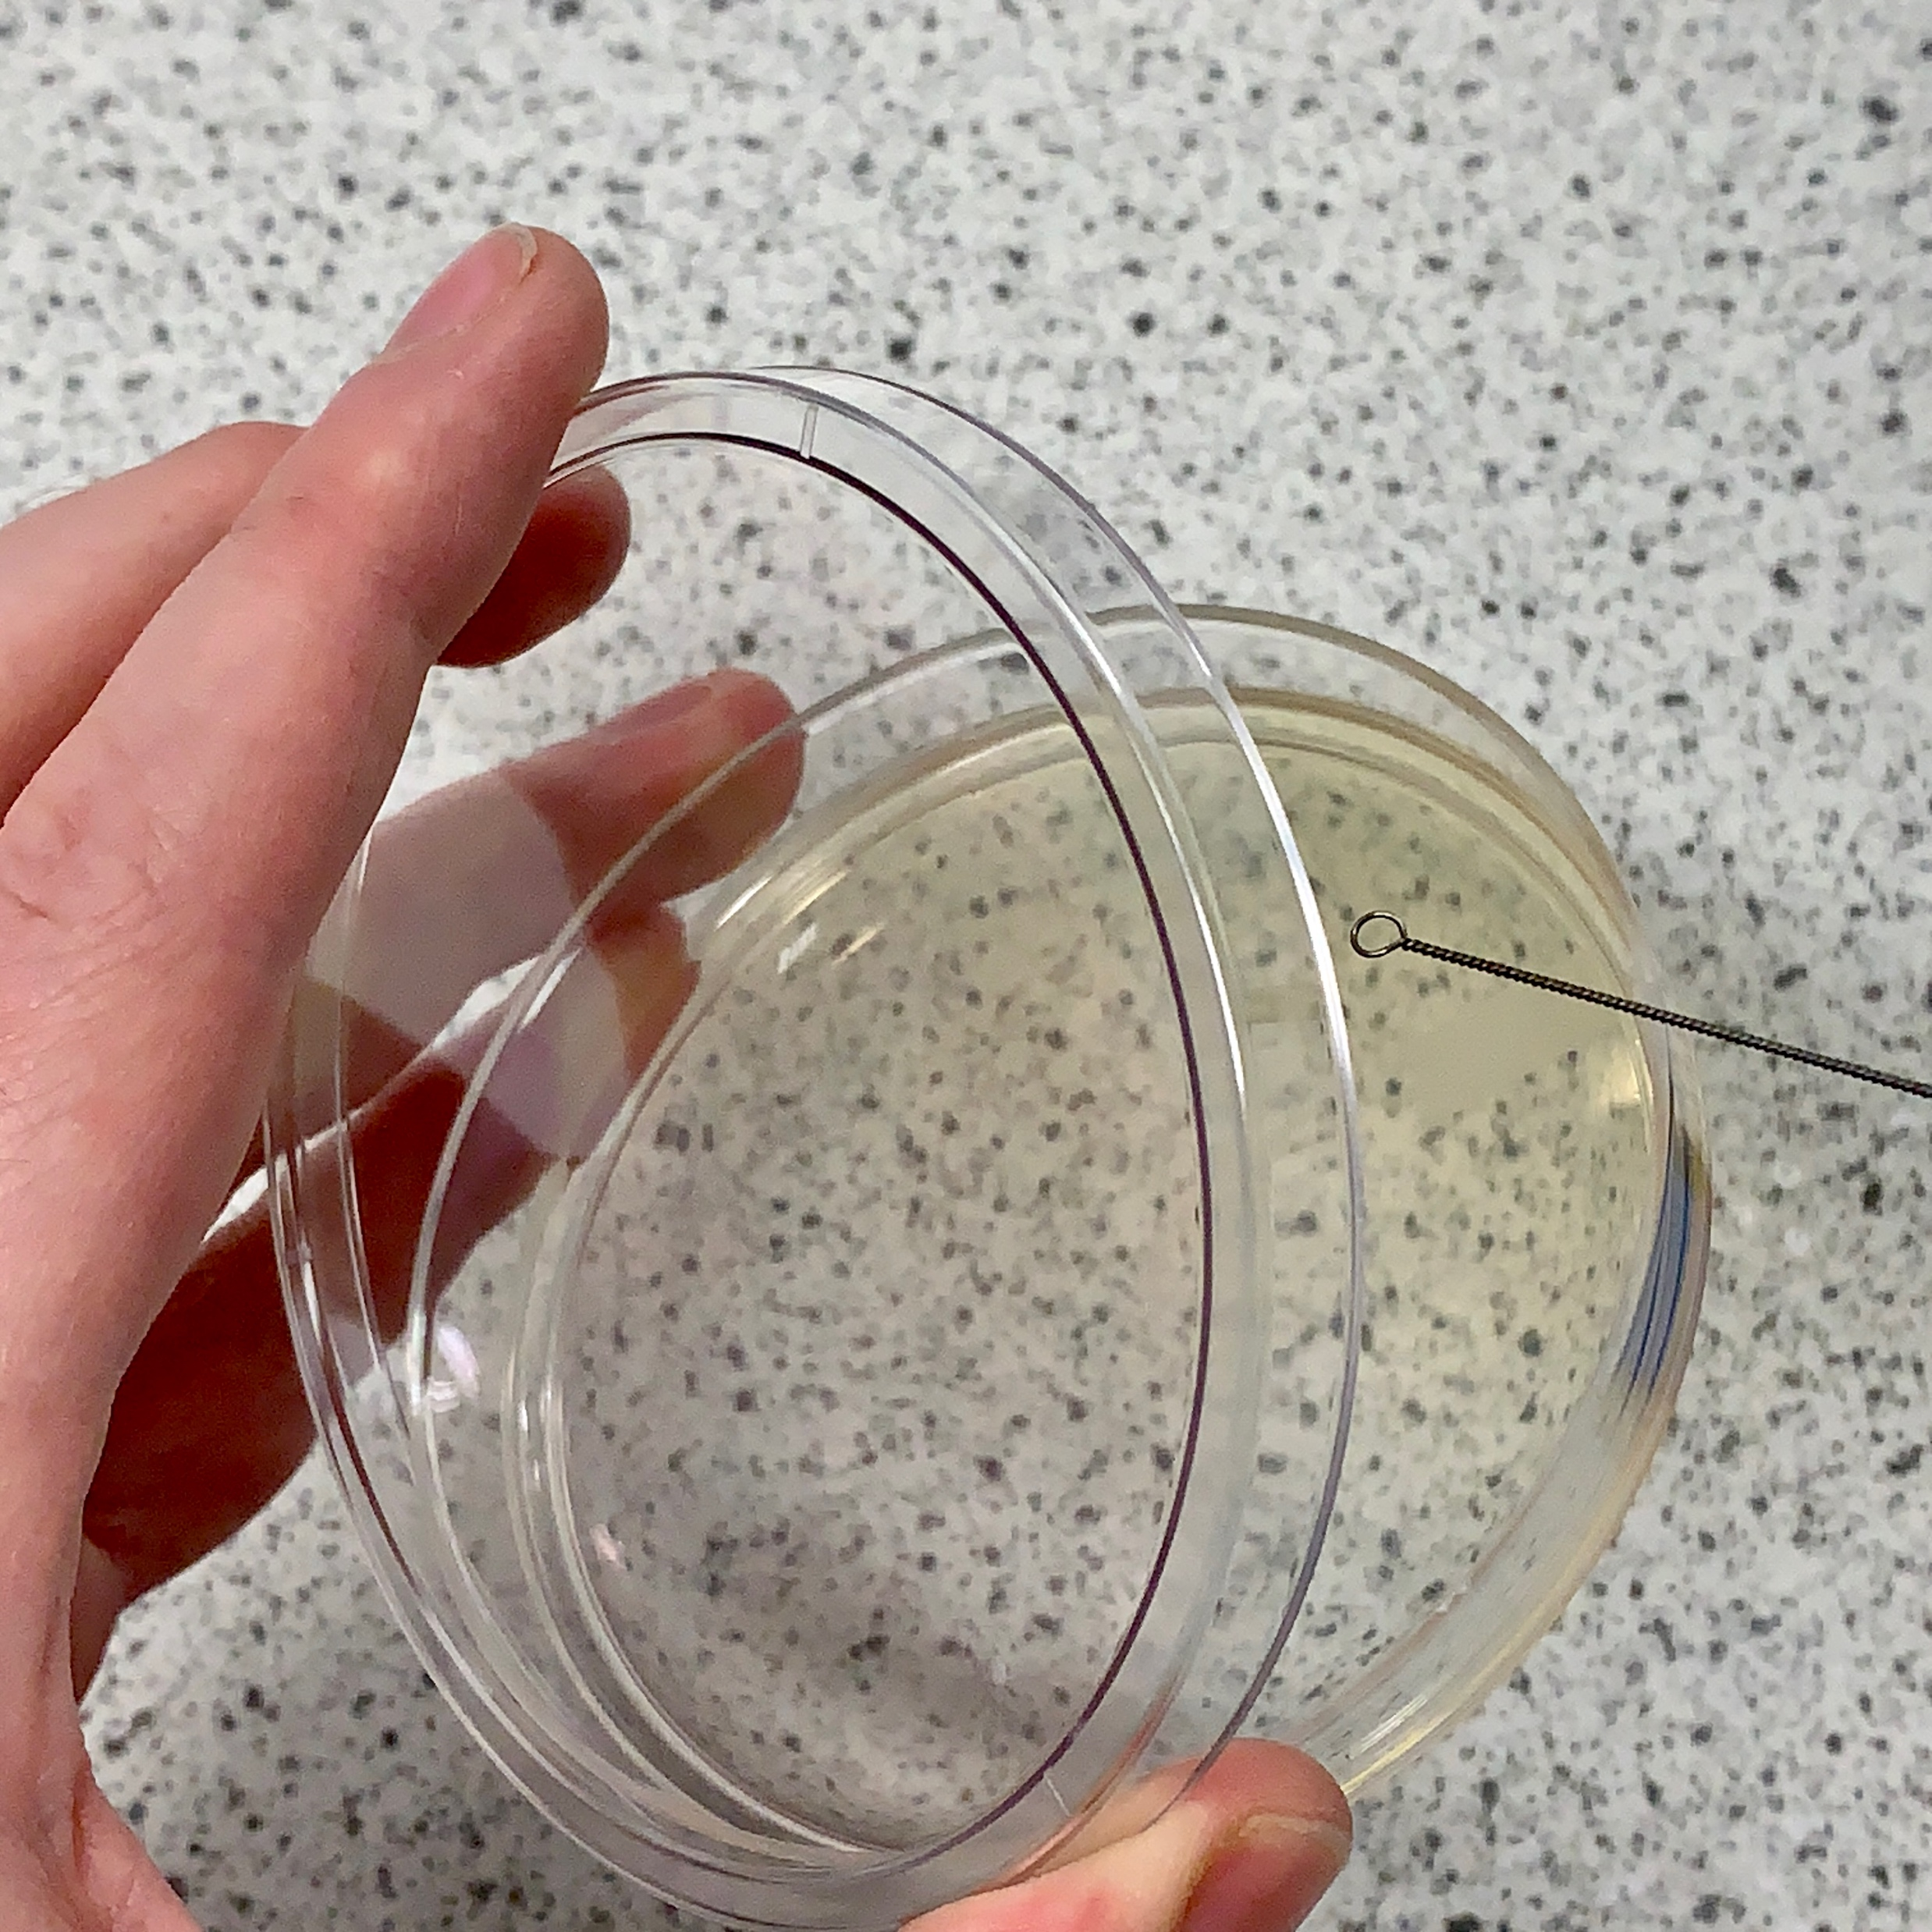
Aseptic Technique
Petri dishes are often used to produce cultures of bacteria and other microorganisms
The aseptic technique must be used to prepare these cultures
This method ensures that the equipment is not contaminated and allows one microorganism to be investigated at a time
Notes:
Type of exposition: Explanation
Suggested Script:
Scientists often need to grow (culture) microorganisms such as bacteria. This may be to find out the source of an infection in a patient or to see what microorganisms may be living in a particular environment. In order to work safely and only grow the bacteria they intend to, scientists use a technique called the aseptic technique which not only ensures that the equipment isn’t contaminated but makes sure that the scientist themselves stays safe from the microorganisms.
Petri dishes are used (hold up a petri dish to show pupils) as they are wide and flat meaning they can grow many microorganisms across a large surface area. This means it will be easier for the scientists to observe the cultures as there will not be layers of microorganisms growing on top of each other.
Inside the petri dishes a growth medium called agar is used- this is a similar texture to jelly, is made from seaweed extract, and contains all of the nutrients needed to successfully grow microorganisms.

Slide 9
Aseptic Technique
Petri dishes and culture media (agar) must be sterilised before use
Agar in Petri dishes must be set
Inoculating loops are used to transfer the bacteria to the agar but must first be sterilised by passing them through a flame
The lid of the Petri dish should be secured with tape and stored upside down
In school laboratories the culture should be incubated at 25 °C.
Notes:
Type of exposition: Explanation/demonstration
Suggested Script:
To be safe only the intended type of microorganism should be grown in the petri dishes, therefore all equipment must be sterilised before use to kill and microorganisms that were present there before. This includes washing hands with soap, sterilising the work area with disinfectant, sterilising the air around the work area by lighting a Bunsen burner and sterilising all equipment intended to be used. Sterilising equipment involves heating it therefore the agar medium will need time to cool down and set- this must be done with the lid on to stop new microorganisms in the air from entering the Petri dish. In school the Petri dishes and agar plates have already been sterilised in the science prep room.
An inoculating loop is used to transfer microorganisms to the agar (hold up an inoculating loop). This must also be sterilised so is passed through the flame of a Bunsen burner immediately before use (turn a Bunsen flame to a roaring flame and hold the loop at the top of the flame for a few seconds). Why is this done? To kill any microorganisms already present on the inoculating loop. The inoculating loop is then dipped into the microorganism sample and carefully distributed across the agar plate.
(At this point demonstrate how to partly lift the lid of the petri dish (shown in picture) and how to streak the surface of the agar in a zig zag fashion without tearing it.)
Once the sample is present on the agar, the lid of the petri dish needs to be secured down with tape upside down to ensure no contamination from other microorganisms while they incubate. Storing them upside down also reduces any condensation from developing in the petri dishes and means it will be easier to see any microorganisms once they have been cultured. The dishes are then left to incubate in an incubator at 25ºC, this temperature allows the microorganisms to grow but reduces the risks of unwanted, dangerous microorganisms from growing.
Suggested guidance: Pupils will need to understand the reasoning for each part of the aseptic technique. Suggested questions below.
Explain why: • Petri dishes and culture media must be sterilised before use – to kill any microorganisms that were already present • inoculating loops used to transfer microorganisms to the media must be sterilised by passing them through a flame – kills any bacteria present on the loop • the lid of the Petri dish should be secured with adhesive tape and stored upside down – stops contamination from microorganisms in the air • in school laboratories, cultures should generally be incubated at 25°C – to allow growth of the bacteria but minimise chance of growing unwanted pathogens
Agar medium is present to allow bacteria access to all required nutrients.

Slide 10
Answer the following questions:
Why is the aseptic technique used?
What is an inoculating loop used for?
Why is the inoculating loop passed through a flame first?
What temperature should cultures be incubated at?
To ensure cultures are not contaminated with unwanted microorganisms (e.g. bacteria or fungi)
Transferring the bacteria or microorganism to the agar
To sterilise it by destroying any other microorganism, preventing contamination
25°C in school laboratories.
Notes:
Purpose: assess understanding of new information. Answers in books or a discussion. Take consensus with answers and ensure no incorrect statements are accepted.

Slide 11

Think outside the box!
What would happen if the Petri dish was sealed on all sides by adhesive tape?
Notes:
Suggested guidance: Students may well say that bacteria ‘die’ but encourage links to aerobic respiration (e.g. what is not able to enter the Petri dish?)
Some students may say that this will be more sterile as ‘nothing will be able to get in’.
You may also want to talk about anaerobic strains of bacteria.
Suggested guidance:
Talk tasks can be used in a variety of ways to suit the particular needs of the students you are teaching. Through exchanging views with others, students develop their understanding of the science beyond what could be achieved individually.
Science classrooms that successfully integrate talk have the following features:
Science talk is a regular feature of lessons and is woven into classroom activities.
Students are paired or grouped strategically by the teacher to ensure productive interaction. This might take into consideration the students’ proficiency of the English language, how encouraging they might be to peers and their attainment in the topic. It’s a good idea to consider these pairings in the class seating plan.
Students are encouraged and supported to talk, but are not forced to talk.
The teacher should take on the role of a facilitator, engaging with conversations where necessary and encouraging or steering the conversation where needed.
Students are encouraged to use the language they have to express their ideas (e.g., everyday language, imperfect English, native language), but also to incorporate science specific terminology where this is more accurate or has been taught.
6. Scientifically inaccurate ideas are not dismissed by the partner or teacher; open discussion and further investigation are relied on to help students construct ideas that support them to progress in their scientific understanding.
7. Guidelines for behaviour during talk tasks are explicit and frequently reviewed. Rules for students might be:
Listen carefully to your partner
Take turns talking.
Speak one at a time, without interrupting.
Politely agree or disagree and explain why.
Politely point out if your partner has used a scientific word incorrectly, if they have explained the science incorrectly, or if there is a more accurate way to describe something.
If confused, ask questions.
Stay focused on the discussion topic.
Respond to one another.

Slide 12
Drill
Explain why the aseptic technique used.
State what is an inoculating loop used for.
Explain why the inoculating loop passed through a flame first.
State the temperature at which should cultures be incubated.
State the function of the agar in the petri dish.
Explain why it is important not to secure the Petri dish with tape on all sides.
Explain why the lid of the Petri dish should be secured with tape and stored upside-down.
Notes:
Purpose: This is a knowledge drill. The purpose of this is to check that the critical knowledge is secure before pupils move onto independent practice.
Suggested guidance: There are a range of ways this could be done depending on time and ability range of the class:
Mini whiteboards
As full sentences in exercise books
As short answers in exercise books
In the pupil workbook
As pair talk
As cold call

Slide 13
Drill answers
To ensure cultures are not contaminated with unwanted microorganisms (e.g. bacteria or fungi)
To transfer the bacteria to the agar
To kill any other microorganisms already present, preventing contamination
25°C
To provide nutrients
Bacteria need oxygen to (aerobically) respire
To stop contamination from microorganisms in the air and to prevent condensation of water which may damage the culture
Notes:
Purpose: This is a knowledge drill. The purpose of this is to check that the critical knowledge is secure before pupils move onto independent practice.
Suggested guidance: There are a range of ways this could be done depending on time and ability range of the class:
Mini whiteboards
As full sentences in exercise books
As short answers in exercise books
In the pupil workbook
As pair talk
As cold call

Slide 14
Practice questions
Answer the following questions in full sentences:
Explain why Petri dishes and agar need to be sterilised before use.
Explain why the lid of the Petri dish should be secured with tape and stored upside-down.
Explain why it is important not to secure the Petri dish with adhesive tape on all sides.
What is the purpose of the agar medium?
To kill any microorganisms that are already present
To stop contamination from microorganisms in the air and to prevent condensation of water which may damage the culture
Bacteria need access to oxygen in order to aerobically respire
To provide nutrients for bacteria to grow
Notes:
An opportunity for students to consolidate their knowledge of aseptic technique – can be used before or after practical
Stretch: What would happen if cultures were incubated at a temperature of 50°C? (opportunity to discuss enzymes denaturing etc. if able)

Slide 15

I: Explain scientific method
Example question:
To ‘explain’ your answer should:
Begin with a scientific statement.
Use ‘this means that’, ‘because’ or ‘so’ to link your statement to the question.
Explain why it is important to:
Not place the inoculation loop on the bench to cool
Place the petri dish at 25°C in a school laboratory instead of 35°C, which would allow bacteria to grow faster
Model answer:
So that there is a lower risk of contamination with other bacteria/microorganisms
So that there is a lower risk of growth of pathogens/dangerous microorganisms which could make students unwell
Notes:
This slide models the process of answering an explain question.
Firstly, students are presented with a generic explain question, along with a model answer. Students are also given some simple guidance to follow for producing their own describe answer.
The generic question and answer should be used by the teacher to remind students of
the key features of a great answer
how to structure their answer
why the model answer is a good example
Following this, students will be required to apply this process to answer their own explain question, which will appear in place of the generic questions. This explain question will be specific to the topic students are learning about in the lesson. Give students time to write their own answer to this, ensuring that they use the guidance provided. To further scaffold this task for students, it may be appropriate to:
pair students up to write an answer together
list for students the key words you would like them to include in the answer
provide a writing frame or ‘points to include’ for students
A model answer for this question will appear. Teachers should review the model answer with students by referencing the guidance in the green box. For example ‘we can see item 1 in the guidance is to begin with a scientific statement. Notice in the model answer here we have done just that’. Or ‘item 2 in the guidance here says that we should use a linking statement in the answer. Has this been achieved in the model answer? Where can we see this?’.

Slide 16
We: Explain scientific method
Example question:
To ‘explain’ your answer should:
Begin with a scientific statement.
Use ‘this means that’, ‘because’ or ‘so’ to link your statement to the question.
When growing one type of bacterium on a culture medium, explain why it is important to sterilize the culture medium and all the apparatus before use.
Model answer:
to kill other microorganisms
or to prevent contamination
to prevent other microorganisms affecting the results
Notes:
This slide models the process of answering an explain question.
Firstly, students are presented with a generic explain question, along with a model answer. Students are also given some simple guidance to follow for producing their own describe answer.
The generic question and answer should be used by the teacher to remind students of
the key features of a great answer
how to structure their answer
why the model answer is a good example
Following this, students will be required to apply this process to answer their own explain question, which will appear in place of the generic questions. This explain question will be specific to the topic students are learning about in the lesson. Give students time to write their own answer to this, ensuring that they use the guidance provided. To further scaffold this task for students, it may be appropriate to:
pair students up to write an answer together
list for students the key words you would like them to include in the answer
provide a writing frame or ‘points to include’ for students
A model answer for this question will appear. Teachers should review the model answer with students by referencing the guidance in the green box. For example ‘we can see item 1 in the guidance is to begin with a scientific statement. Notice in the model answer here we have done just that’. Or ‘item 2 in the guidance here says that we should use a linking statement in the answer. Has this been achieved in the model answer? Where can we see this?’.

Slide 17
We: Explain scientific method
Example question:
To ‘explain’ your answer should:
Begin with a scientific statement.
Use ‘this means that’, ‘because’ or ‘so’ to link your statement to the question.
A student investigated the effectiveness of four different antibiotics. The student used the aseptic technique to ensure that only one type of bacterium grew on the agar. Explain two aseptic techniques the student should have used.
Model answer:
Sterilise petri dishes and culture (agar) before use so that they are not contaminated
Sterilise the inoculating loop first by passing it through a flame so that it is not contaminated
Lid of agar dish must be secured with tape and stored upside down so that there is no contamination of microorganisms into the air and to prevent condensation of water which may damage the culture
Notes:
This slide models the process of answering an explain question.
Firstly, students are presented with a generic explain question, along with a model answer. Students are also given some simple guidance to follow for producing their own describe answer.
The generic question and answer should be used by the teacher to remind students of
the key features of a great answer
how to structure their answer
why the model answer is a good example
Following this, students will be required to apply this process to answer their own explain question, which will appear in place of the generic questions. This explain question will be specific to the topic students are learning about in the lesson. Give students time to write their own answer to this, ensuring that they use the guidance provided. To further scaffold this task for students, it may be appropriate to:
pair students up to write an answer together
list for students the key words you would like them to include in the answer
provide a writing frame or ‘points to include’ for students
A model answer for this question will appear. Teachers should review the model answer with students by referencing the guidance in the green box. For example ‘we can see item 1 in the guidance is to begin with a scientific statement. Notice in the model answer here we have done just that’. Or ‘item 2 in the guidance here says that we should use a linking statement in the answer. Has this been achieved in the model answer? Where can we see this?’.

Slide 18
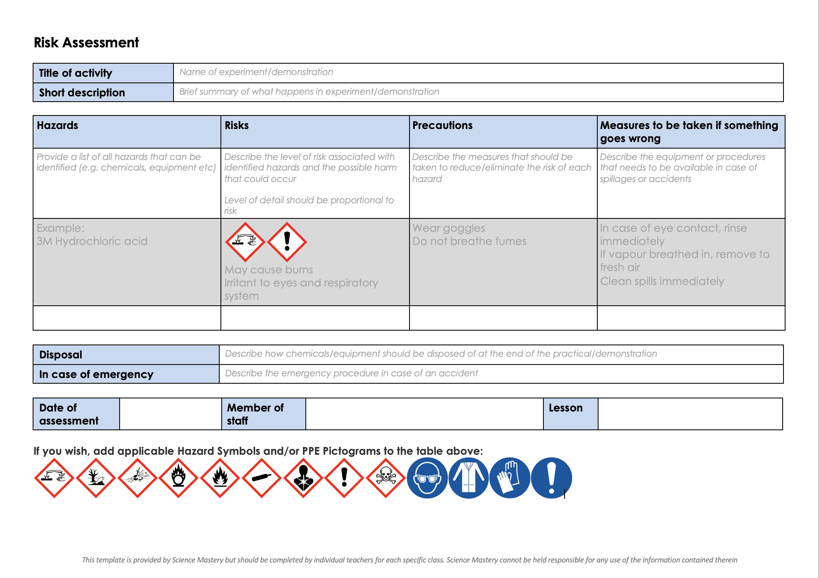
Risk Assessment
A risk assessment must be completed for this practical
The template risk assessment can be found here.

Slide 19
Aseptic Technique Practical
Follow the instructions on the practical sheet to carry out the experiment.
Notes:
Separate teacher guidance for practical and integrated practical instructions for pupils.
Cultures should be left for 48 hours.

Slide 20
Answer the questions below.
Which best explains why the aseptic technique is used?
A. To ensure that there is no contamination when preparing a culture
B. To ensure that the Petri dish is clean
C. To ensure that all microorganisms are allowed to grow
2. Which is not a feature of the aseptic technique?
A. Sterilising the inoculating loop using a flame
B. Securing the Petri dish lid by making an airtight seal
C. Sterilising the agar before use
3. What is the function of the agar in a Petri dish?
A. To provide nutrients
B. To sterilise the petri dish
C. To destroy any microorganisms
✓
✓
✓
Notes:
Purpose: to find out if students are able to answer key questions that check for understanding of the new information/skills that have been covered.
Suggested guidance:
Give students thinking time and then ask for feedback – either holding up fingers for the right number/letter, using mini whiteboards or just writing answers down in books quickly before cold calling.
Answers:
Answers:
Q1. Answer: A
If pupils answered B they have confused part of the aseptic technique with the reason for doing it.
Q2. Answer: B
If pupils answered A or C they have misconceptions around the aseptic technique.
Q3. Answer: A
If pupils answered B or C they have misconceptions around the aseptic technique
To fix it for any of these misconceptions it may help for pupils to write out their own method of the aseptic technique and to explain the rationale behind each step. You may also want get pupils to write a mnemonic to help them remember the steps involved. A task of matching the steps to reasons would also work. Remind pupils that the purpose of the activity today was to not grow any bacteria as the aseptic technique was being practised. Usually specific microorganisms would be cultured not none at all!

Slide 21
Lesson B3.1.3
What was good about this lesson? | What can we do to improve this lesson?
Send us your feedback by clicking this link
or by emailing sciencemastery@arkonline.org
Thank you!

